Slide 1
Lottie Animation

Slide 2
What is Lottie
A Lottie is a JSON-based animation file format that allows you to ship animations on any platform as easily as shipping static assets.
They are small files that work on any device and can scale up or down without pixelation.
LottieFiles lets you create, edit, test, collaborate on and ship a Lottie in the easiest way possible.
Lottie animations are much smaller while retaining the same quality compared to other formats like GIF or MP4.
Lottie animations are based on vectors, which means you can scale them up and down without worrying about resolution.
Multi-platform support and libraries

Slide 3
What is Library
It is structurally the same as an Android app module.
It can include everything needed to build an App.
Instead of compiling into an APK, it complies into an Android Archive (AAR) file that is used as a dependency for an Android app module.
Unlike JAR files, AAR files offer the following functionality for Android apps:
AAR files can contain Android resources and a manifest file, which lets you bundle in shared resources like layouts and drawables in addition to Kotlin or Java classes and methods.
AAR files can contain C/C++ libraries for use by the app module's C/C++ code.

Slide 4
Why library
A library module is useful in the following situations:
When building multiple apps that use some of the same components, such as activities, services, or UI layouts
When building an app that exists in multiple APK variations, such as a free and paid version, that share core components
In either case, move the files you want to reuse into a library module and then add the library as a dependency for each app module.

Slide 5
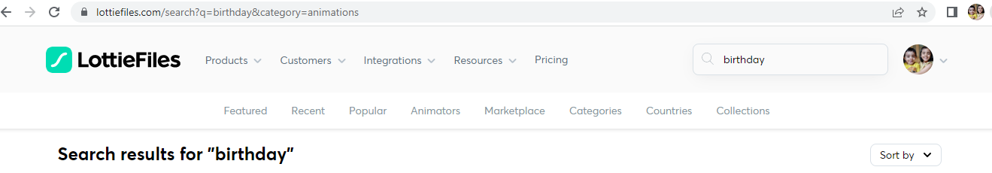
How to get Lottie Files
https://lottiefiles.com/ use this official website
You can create your account there
Then sign in
Simply search the animation from the above link

Slide 6
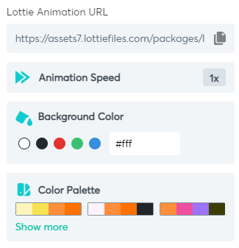
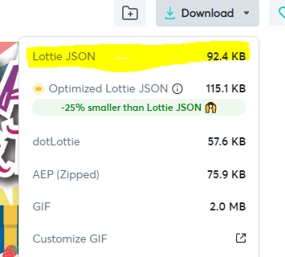
Download Lottie Animation
Click on the animation you want to download, a new detailed window appears.
You can adjust play speed and color combo of animation from this palette.
To download click on download and download JSON file.
You can change the name of lottie animation JSON file, the name should not start with numbers.

Slide 7
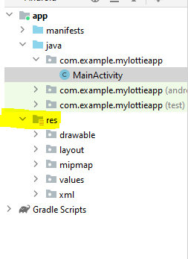
Create New Project to use lottie animation
Create a new project
Select Empty activity and press Finish.
Now we have to paste that JSON file in our project. All the media will be pasted in “res” directory
Now right click on the “res” directory, then click “New”, then click on “Android Resource Directory”
A new dialog box appears, give the directory name as “raw” (all small letters) and click “OK”.
A new folder named “raw” is created in “res” directory.
Now paste the copied JSON file in raw folder and press ok. You can rename the file here as well.

Slide 8
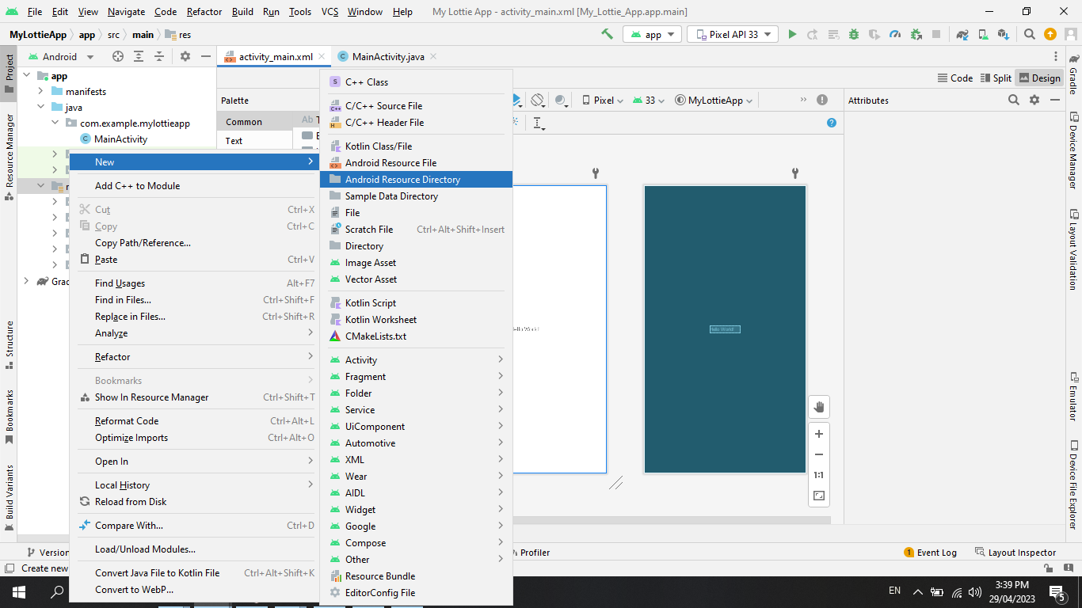

Slide 9
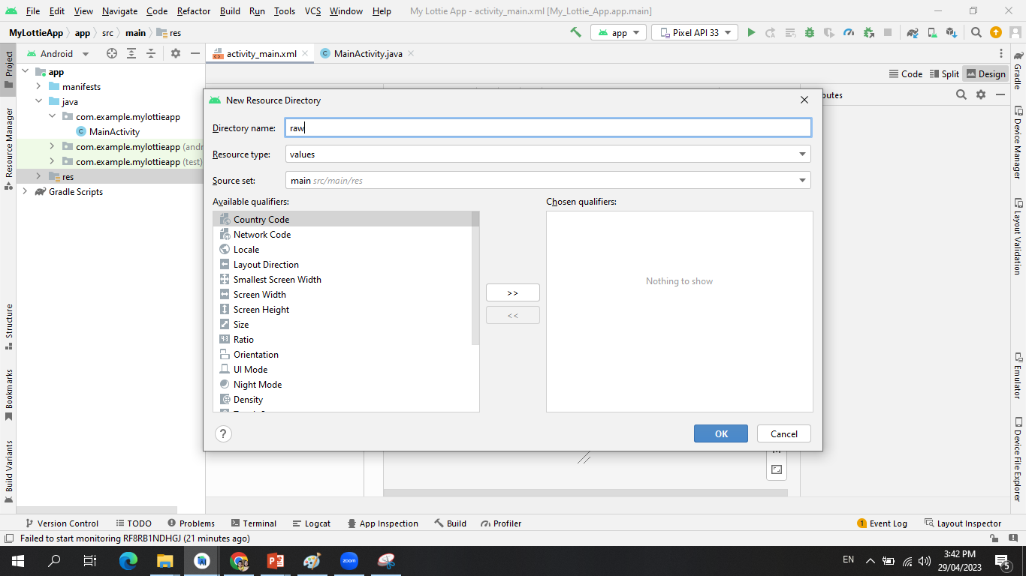

Slide 10
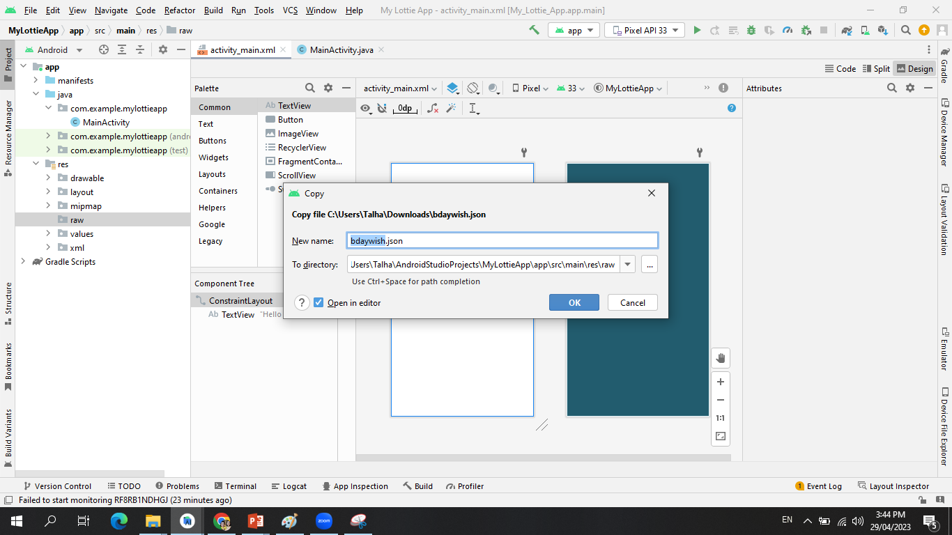

Slide 11
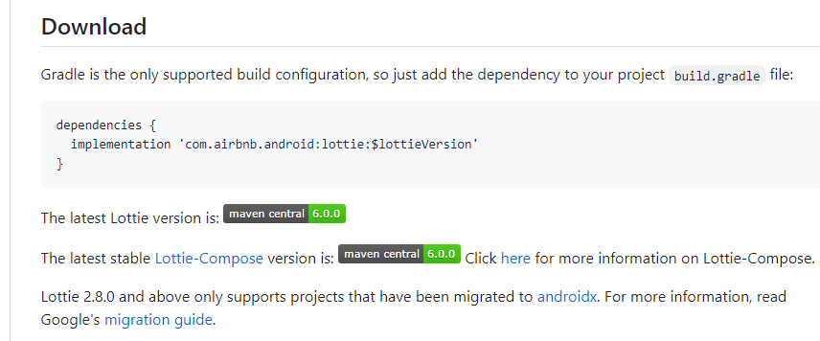
Library integration
Now to use lottie animation in my android project. We have to integrate lottie animation project in our android project.
This will give us lottie animation view which will convert downloaded JSON file as animation file to be used by our android project.
Now open your browser and search “lottie animation github”
Open the first link of githubt
Scroll down to the following part: https://github.com/airbnb/lottie-android

Slide 12
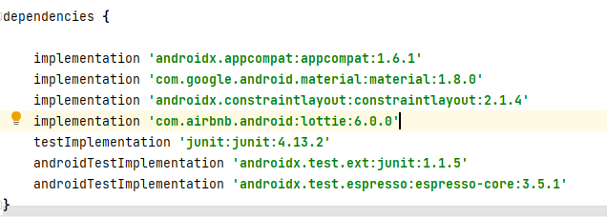
Now copy the dependencies code as it is:
implementation 'com.airbnb.android:lottie:$lottieVersion'
Now here we have to replace $lottieVersion with lottie version available on the site, currently 6.0.0 version is available.
Now go to your project
Expand “gradle” of left most panel of your project.
Click on the build.gradle of your app (the first build.gradle file belongs to project you have to click on the second file that is for app)
Now paste the above copied code in the dependencies. Replace the $lottieVersion with the version available on the site.

Slide 13
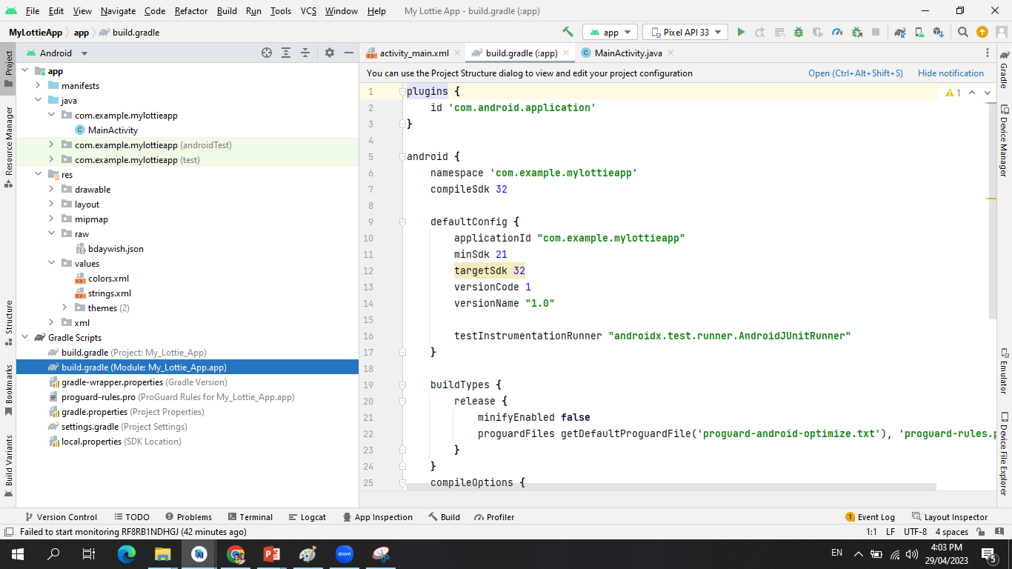

Slide 14
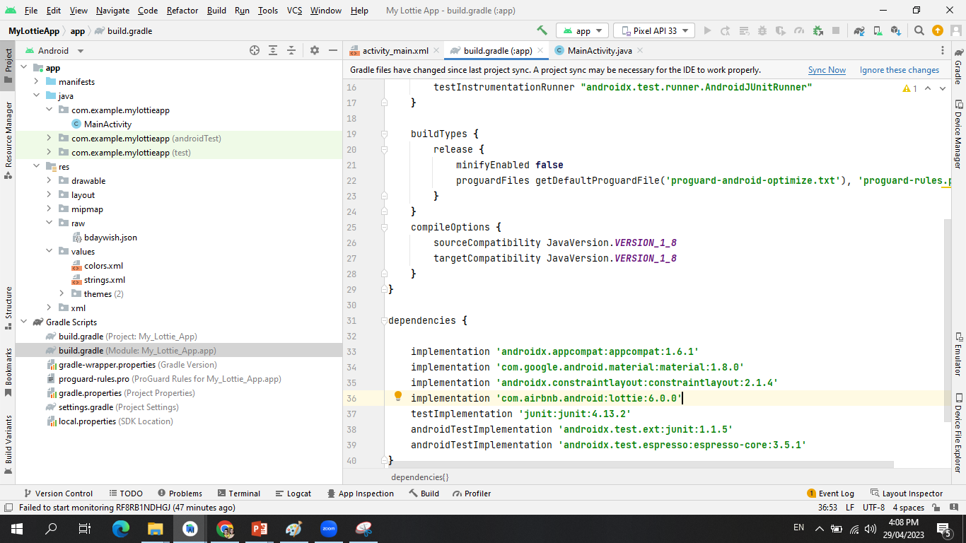
Whenever we integrate the library in our project we have to sync it. As dependency is URL, so to sync it there will be “sync now” option available at top, click on that. You should have an active internet connection. It will download the animation project and integrate it with our android project.

Slide 15
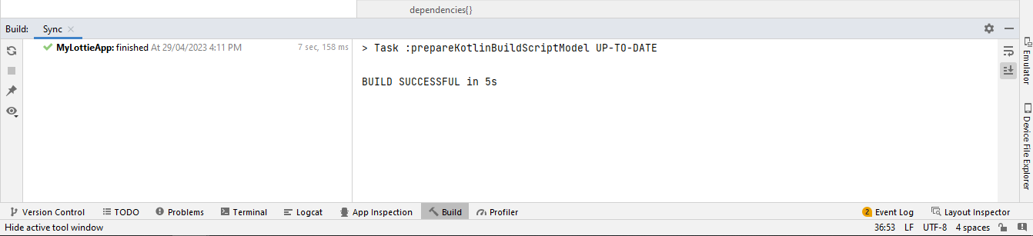
After Syncing your project, once your Build is successful now you can proceed further.

Slide 16
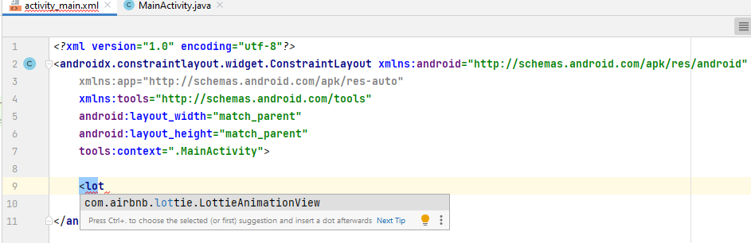
Open XML file of MainActivity.
Start a tag “<“ and just right lottie and take lottie animation view.
The tag is completed when you take lottie animation view, you can give height and width here.

Slide 17
To set the lottie animation file in XML, we take rawres and then give the name of our lottie file by telling the folder name that is @raw. To give the name write @raw/filename.
app:lottie_rawRes="@raw/bdaywish“
Now take the autoplay and set is true, it will play it automatically whenever we open the file, we set it true when we want to play the animation directly from XML, no code required to be done in JAVA file.
app:lottie_autoPlay="true“
If we want to play the animation in loop the we will take loop and set it as true.
app:lottie_loop="true“
It will directly run the animation without any code in JAVA, if we want o run our animation by clicking some button etc then we have to do some code in java.

Slide 18
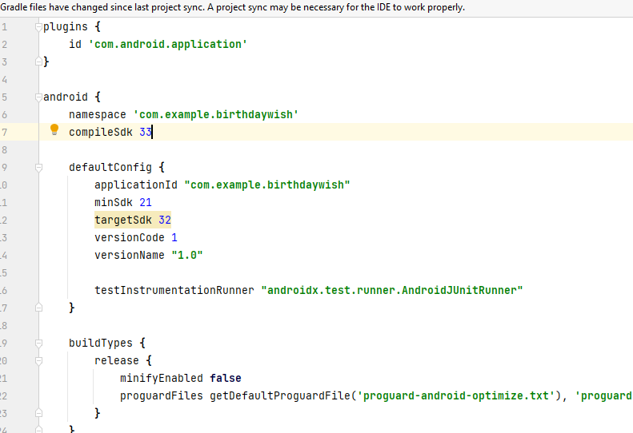
Minimum compilesdk required is 33 and minsdk required is 16, so if the app is not successfully running then open gradle.build for your app and change the sdk accordingly to run it successfully. Then click on sync now, whenever you make a change in gradle.build always sync the file.

Slide 19
Lottie animation play using JAVA file
Go to the java file, take LottieAnimationView as first line under MainActivity class. Make a variable for LottieAnimationView.
public class MainActivity extends AppCompatActivity {
LottieAnimationView myView;
Now you can set any view for your variable under the following code.
setContentView(R.layout.activity_main);

Slide 20


Run your Lottie Animation by clicking on the button (Java code)
Here we declared a variable for LottieAnimationView and a Button.
Connect the above declared variable with their design views using findViewById method.
The findViewById() method is a method of Android's View and Activity classes.
The method is used to find an existing view in your XML layout by its android:id attribute.

Slide 21
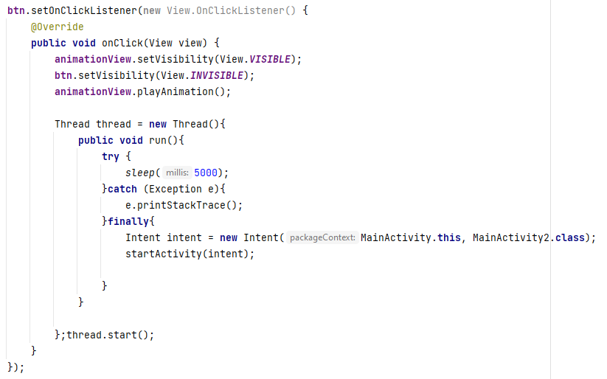
The code behind button >>>>
animationView.setVisibility(View.VISIBLE); // this line is used to set visibility of lottie animation once the button is clicked.
btn.setVisibility(View.INVISIBLE); //we hide button visibility when clicked to play animation.
Thread class is used to add delay for the next activity intent. It will help to sleep the next intent for 5 secs usinh try and catch and finally method of Thread class

